Slide 1
Autonomous Ground Support Equipment Design, Construction & Implementation NASA Student Launch Initiative
Pranav Srinivas Kumar & William Emfinger
Dr. Anilkumar
Vanderbilt Aerospace Club
The 2014-15 Aerospace Club was sponsored by the Department of Mechanical Engineering and the Boeing Corporation.

Slide 2
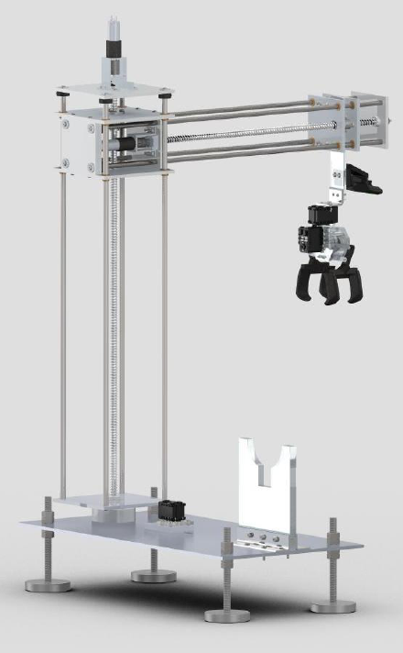
Overview
Autonomous Ground Support
Sample Retrieval
Design Goals
Reliability
Simplicity
Robustness
Design Considerations
Minimum degrees of freedom
Image Processing
Distributed Embedded System
User Input Panel
Model-driven software
development

Slide 3
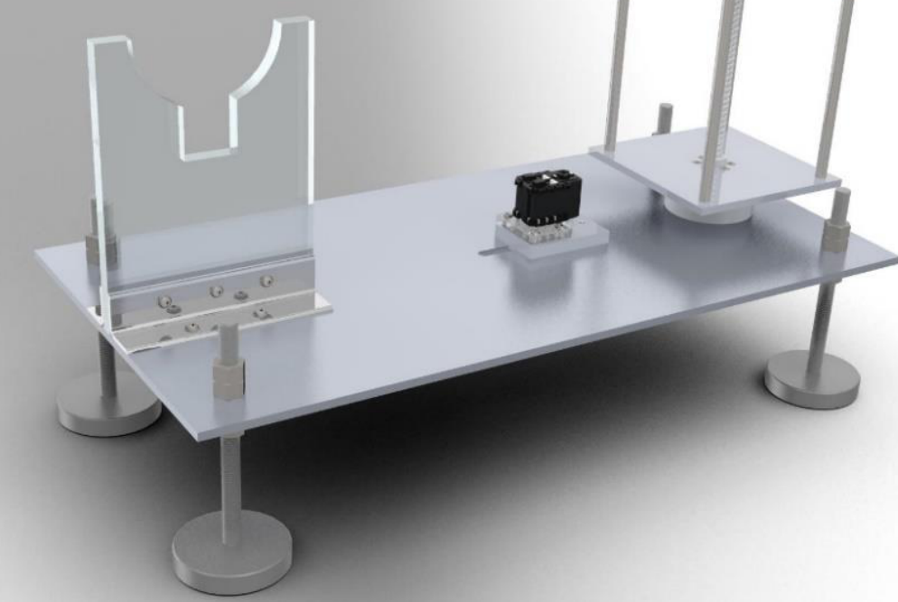
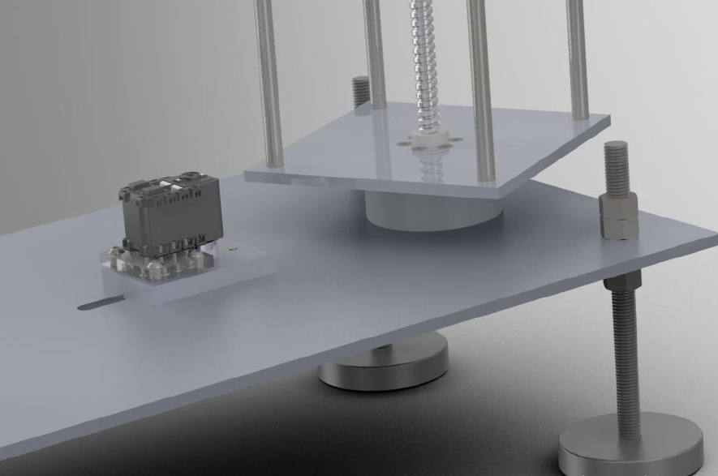
Mechanical Construction (1/3)
AGSE Base Table
25.5” tall and up to 19.5” radial reach
Adjustable leveling feet
Rocket stand and Base rotation system

Slide 4
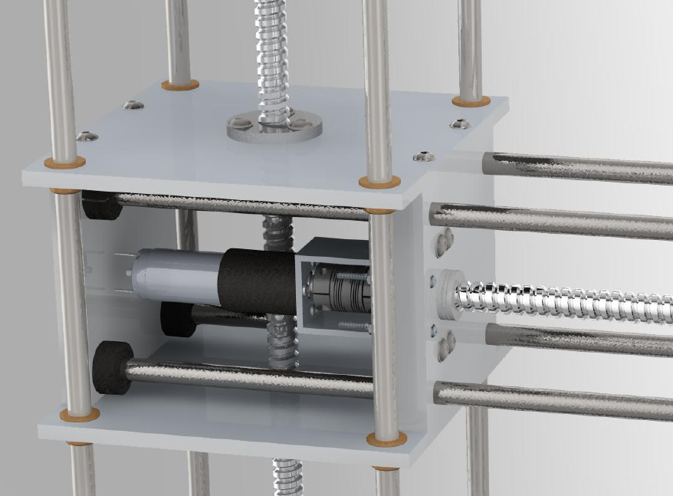
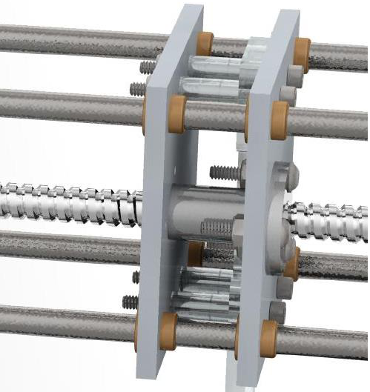
Mechanical Construction (2/3)
Lead Screw Linear Actuation
Faulhaber 12V, 8.1W motors
Vertical carriage supports a horizontal powertrain

Slide 5
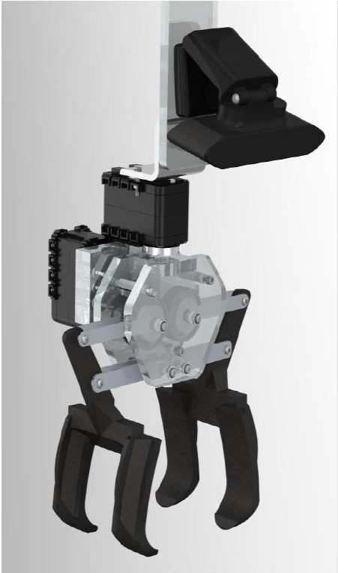
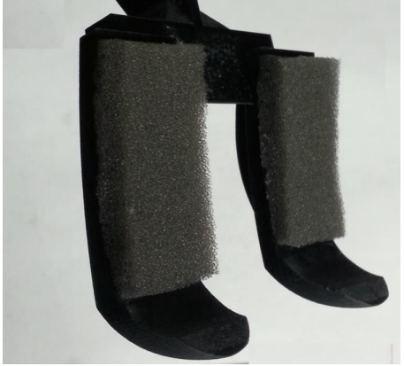
Mechanical Construction (3/3)
AGSE Gripper
Optimized phalange curvature
Acrylic “gear box”

Slide 6
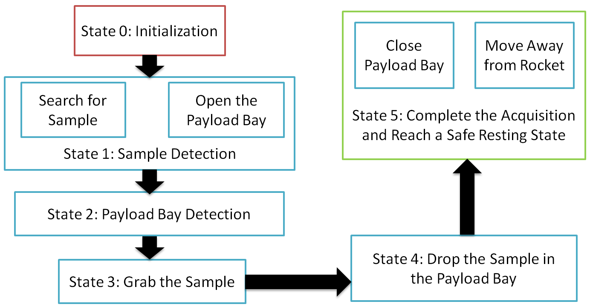
AGSE Overview

Slide 7
AGSE Electronics (1/3)
Developed custom PCB
Attaches to BeagleBone Black as a cape
Provides functionality for
Serial buffer for UART from 3.3V to 5V for control of servos
H-Bridge for Vertical Motor
H-Bridge for Radial Motor
Power supply from main 12V system
Radial axis quadrature encoder
Vertical axis quadrature encoder

Slide 8
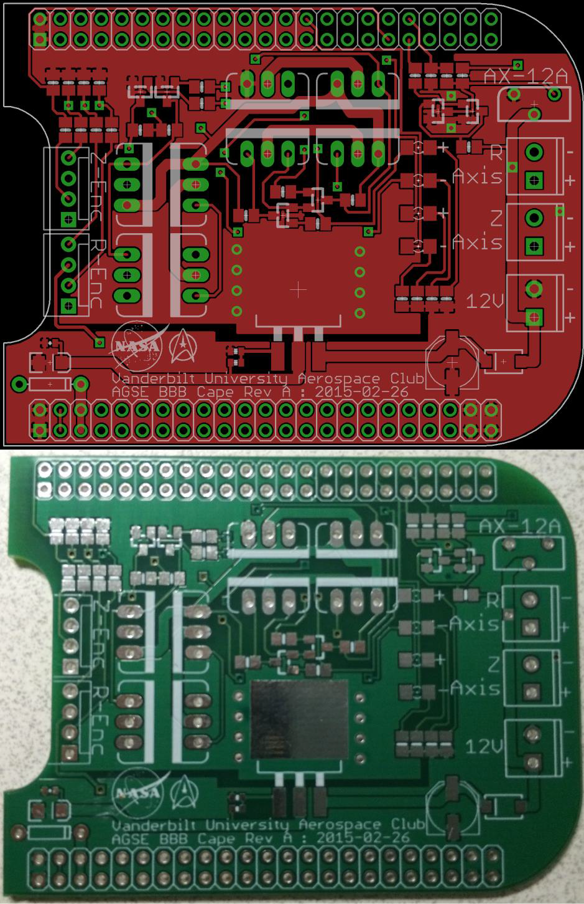
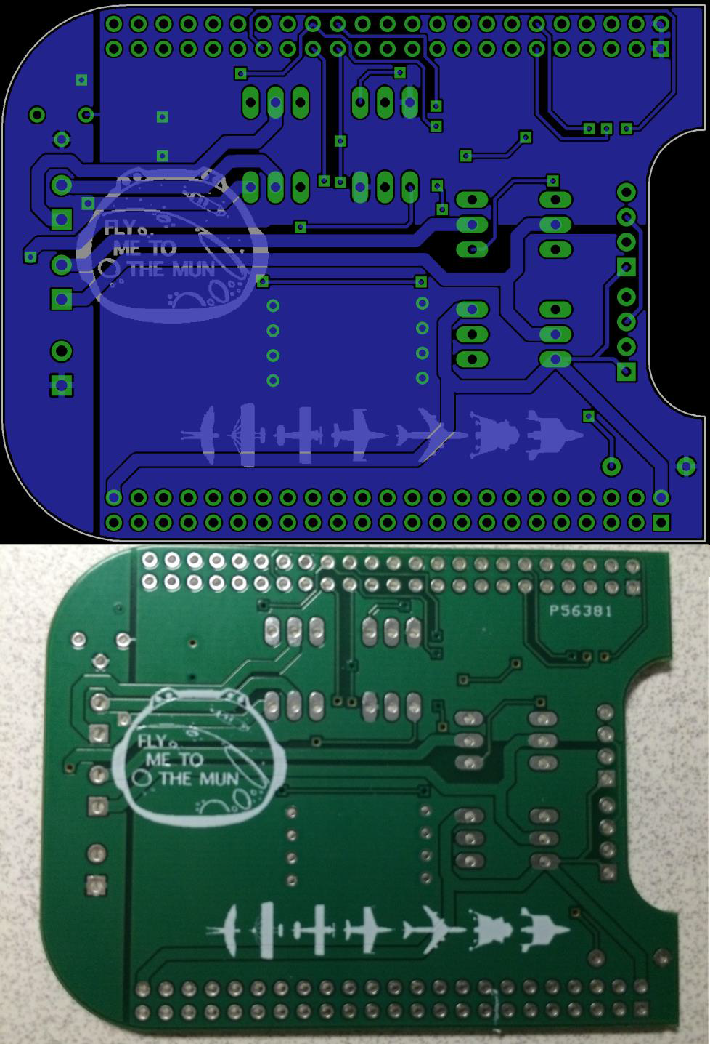
AGSE Electronics (2/3)

Slide 9
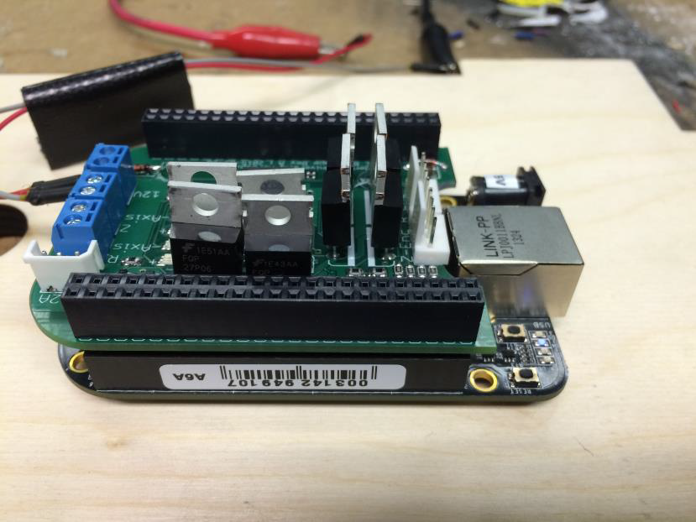
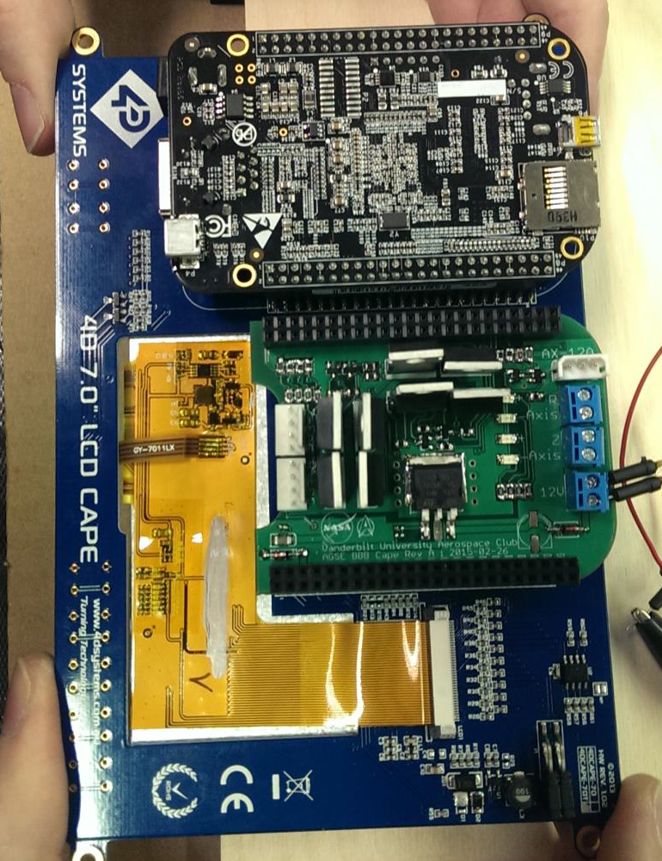
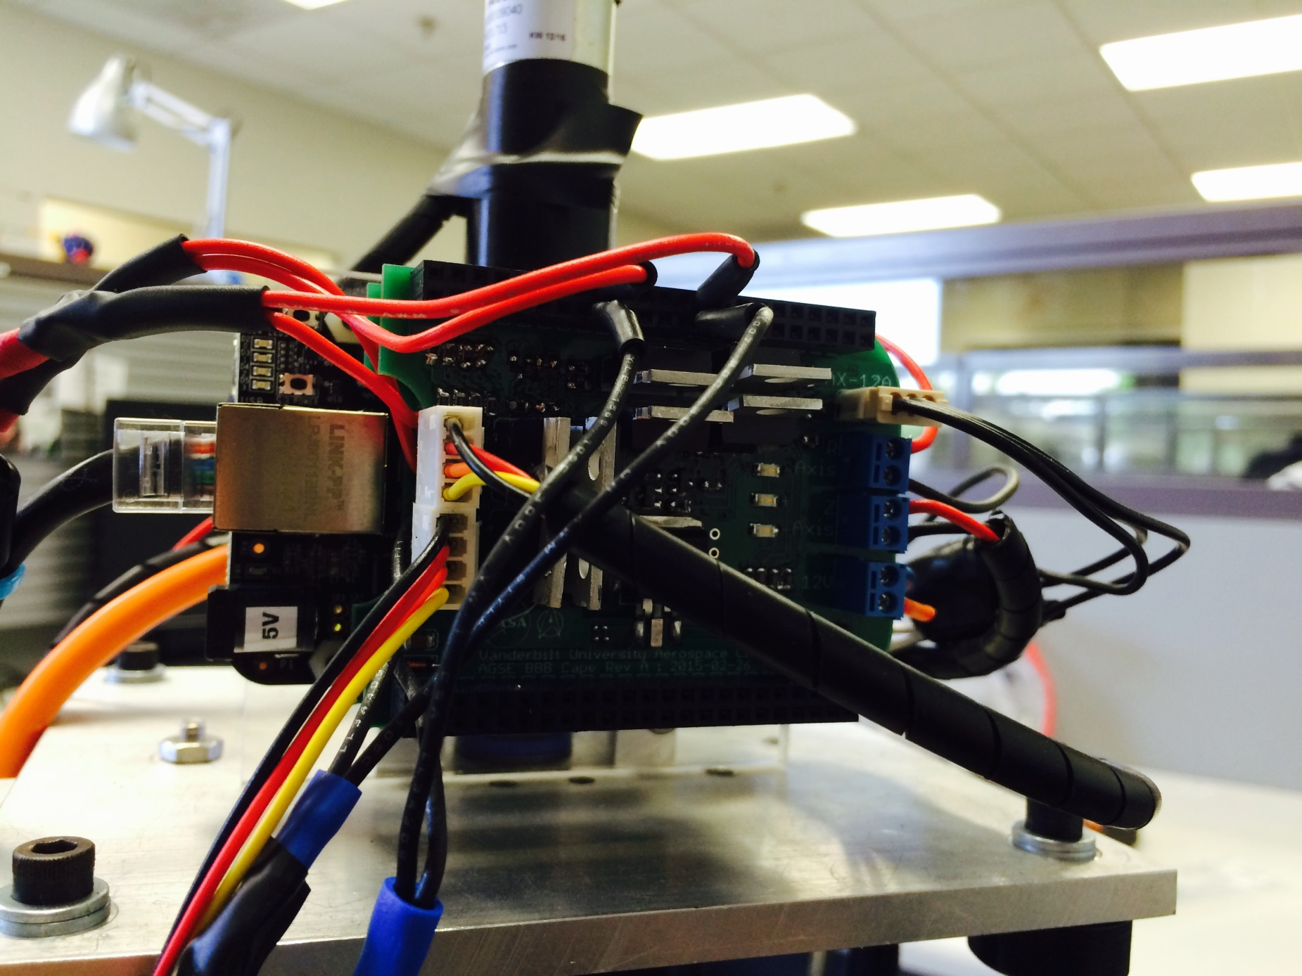
AGSE Electronics (3/3)

Slide 10
Image Processing – Sample Detection
OpenCV software library
Computer vision to classify and track observed objects in real-time
Periodic Processing
Convert RGB image frame to HSV/Grayscale image frame
Apply thresholding, filtering, erosion and dilation procedures
Draw contours around detected objects
Calculate position & relative orientation

Slide 11
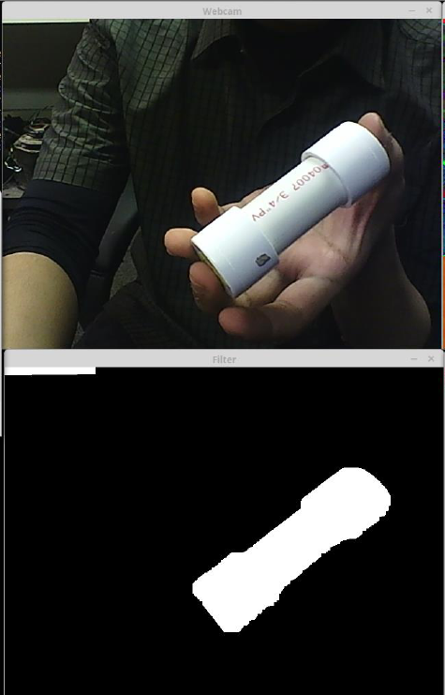
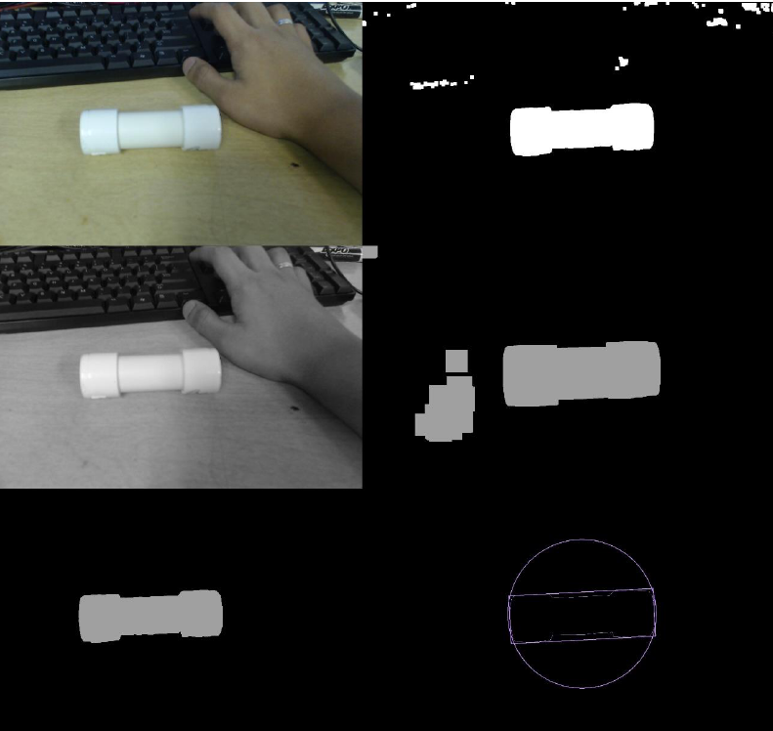
Real-time Object Tracking

Slide 12
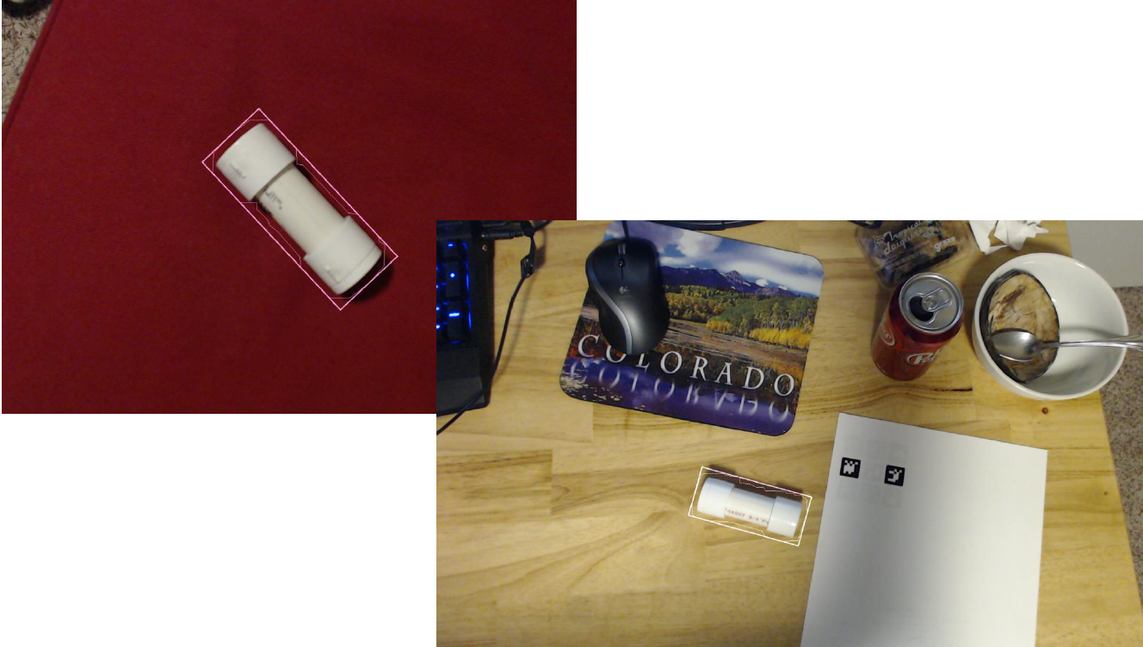
Heuristics - Area-based Filtering

Slide 13
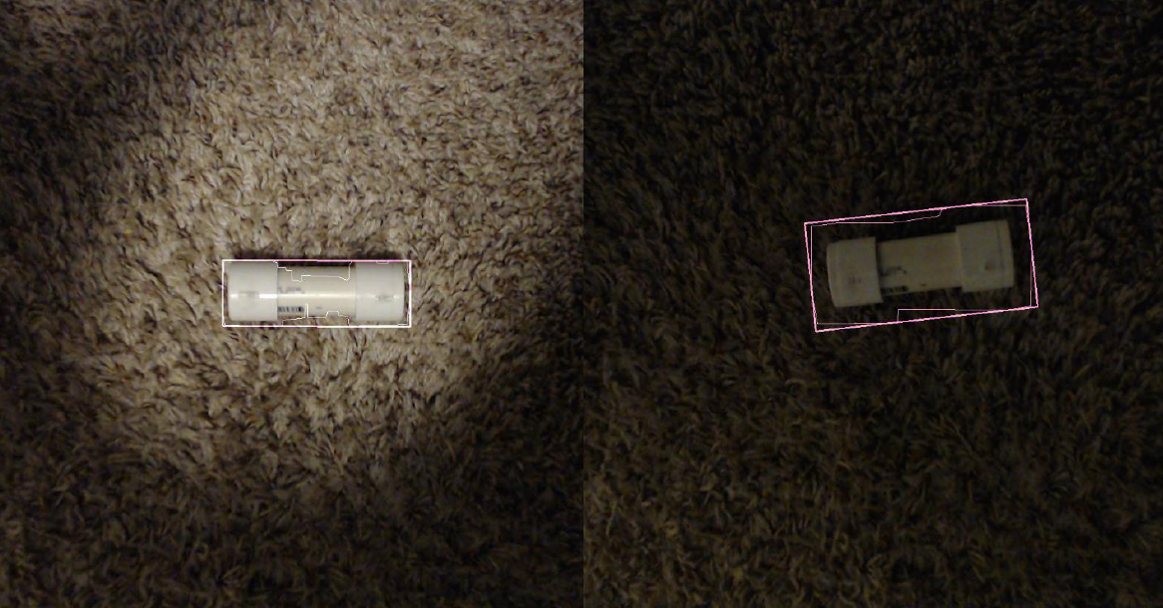
Low Light Testing

Slide 14
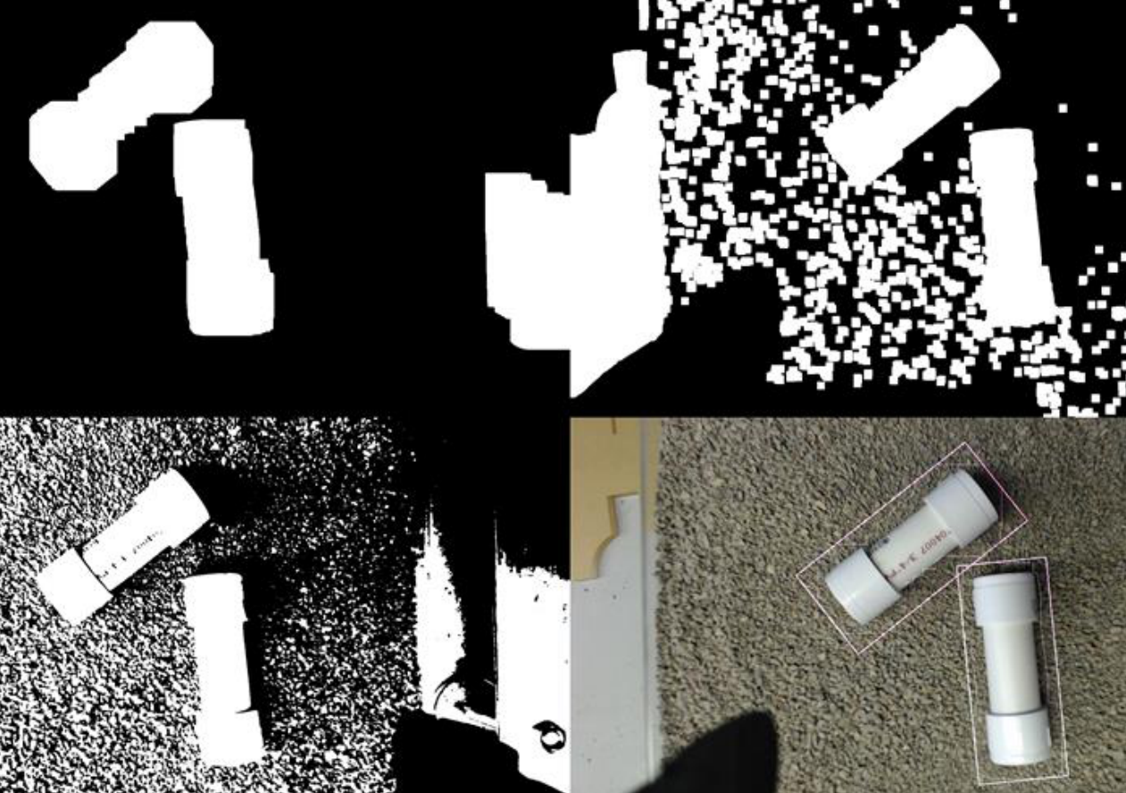
Multiple Sample Detection

Slide 15
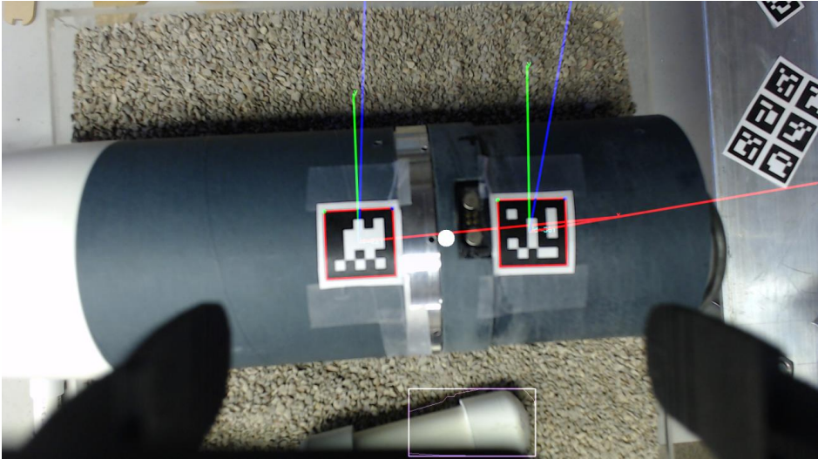
Payload Bay Marker Detection

Slide 16
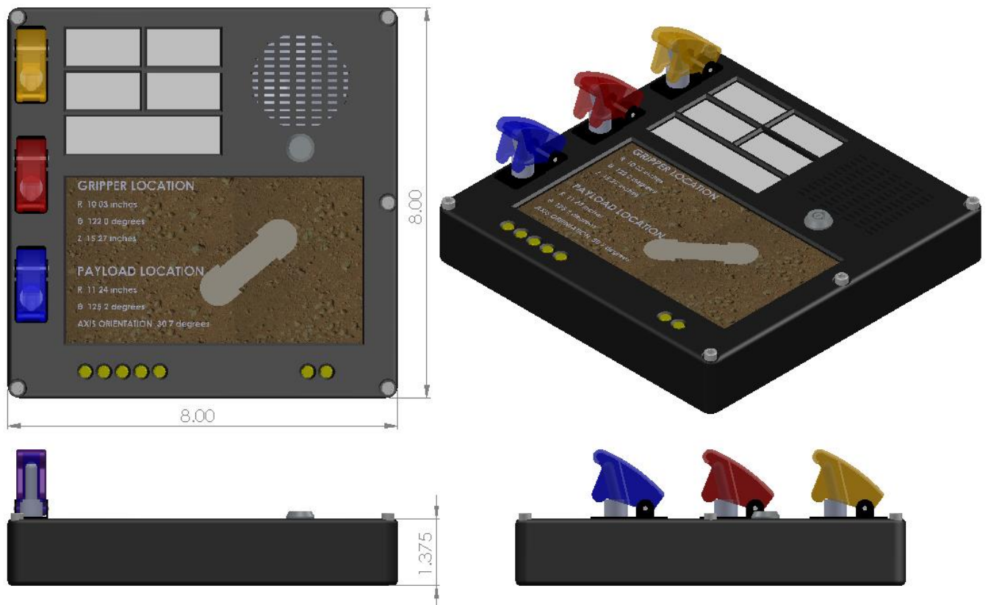
User Input Panel

Slide 17
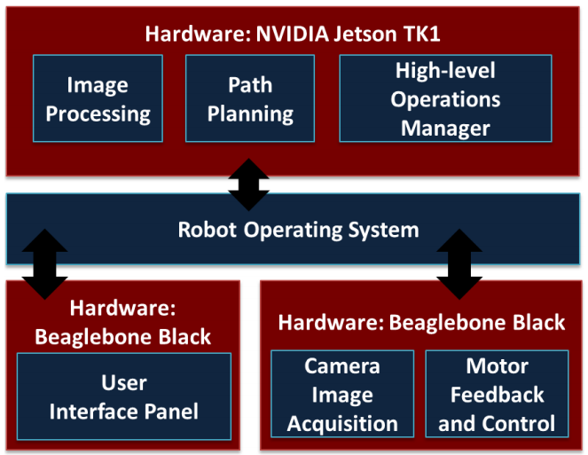
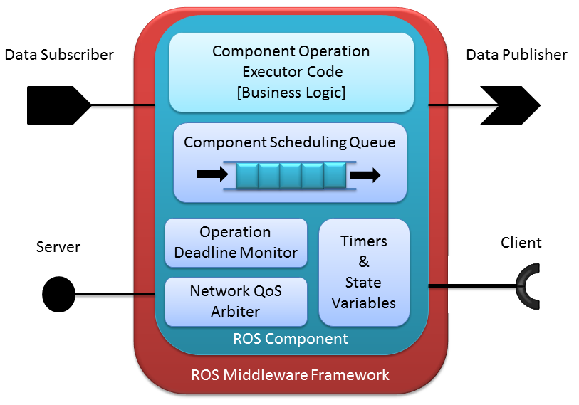
Software Development Robot Operating System & ROSMOD
Distributed Embedded System
Use Robot Operating System
ROSMOD Component Model
Modeling, Code Generation & Deployment tool suite

Slide 18
ROSMOD Projects
Software Workspace Model
Messages, Services & Component definitions
Workspace & build system generation
Hardware Model
IP Address, Architecture & network topology
Deployment Model
Process-to-Hardware mapping
Component Instantiation in processes
Deployment-specific XML Generation

Slide 19
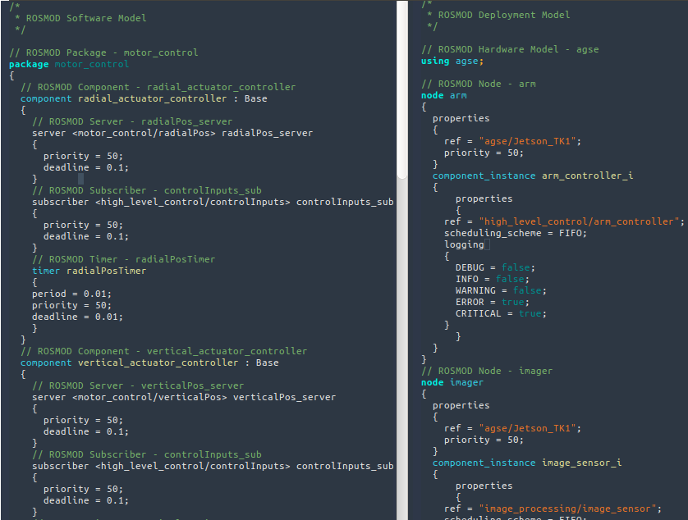
Textual Language

Slide 20
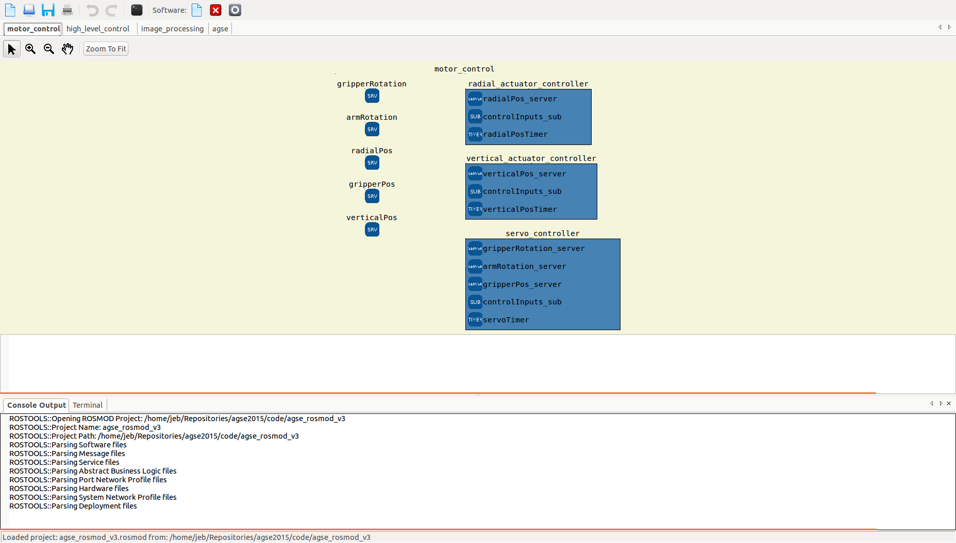
Graphical Editor
Definitions of ROS Messages & Services that are used by component ports
Definitions of all Components in the “motor_control” Application

Slide 21
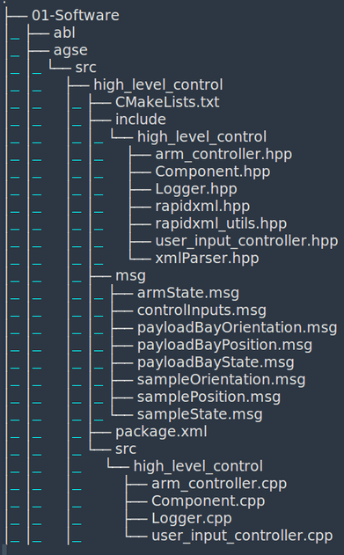
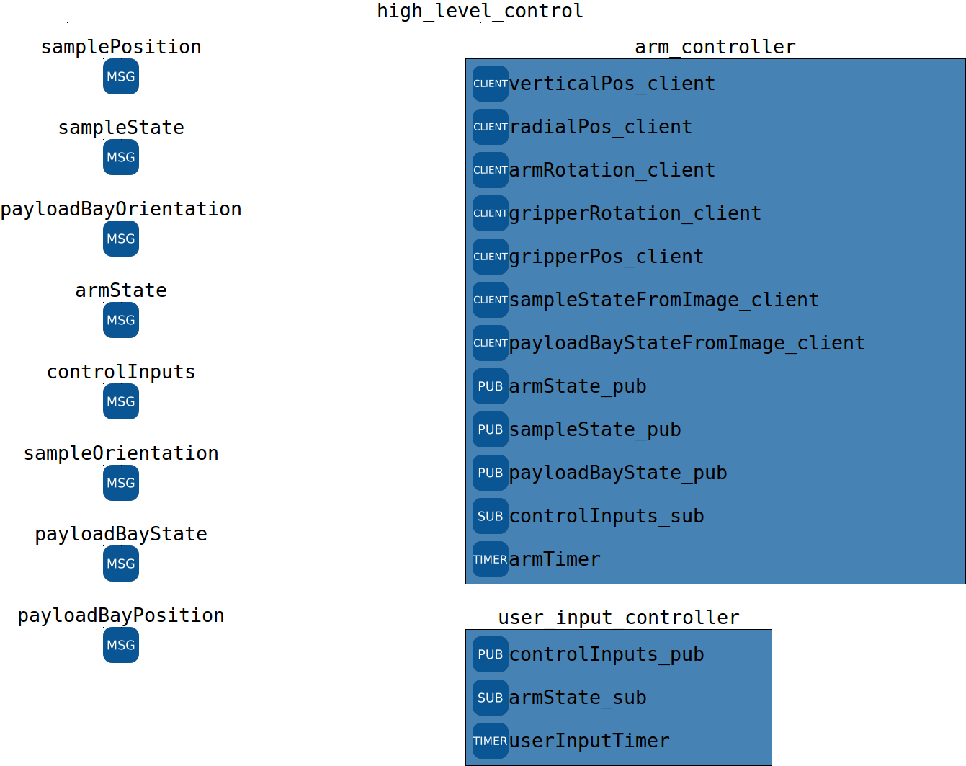
Workspace Code Generation

Slide 22
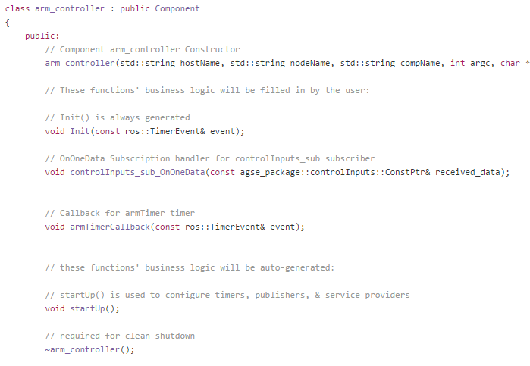
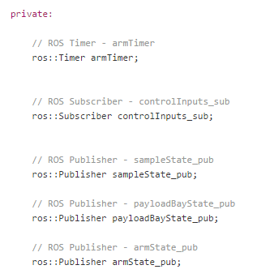
Generated Skeleton Code

Slide 23
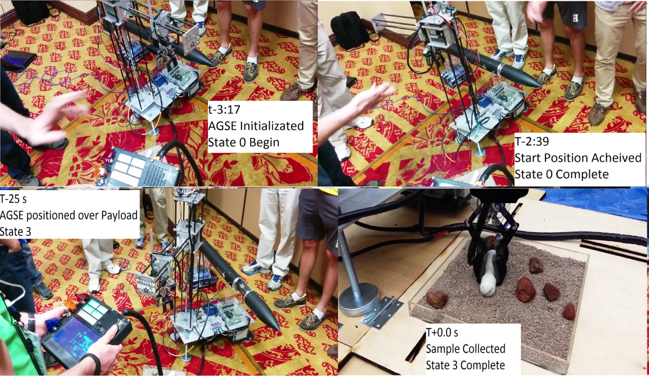
AGSE Performance

Slide 24
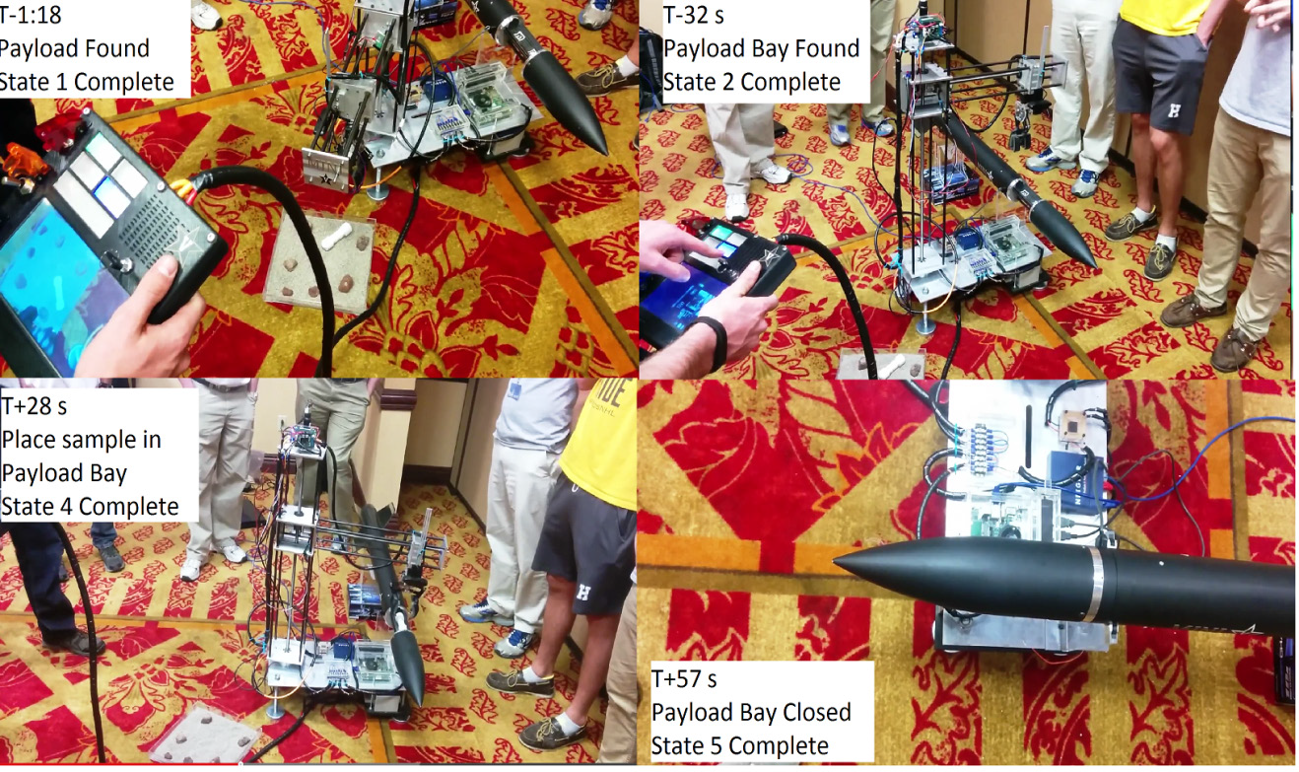
AGSE Performance

Slide 25
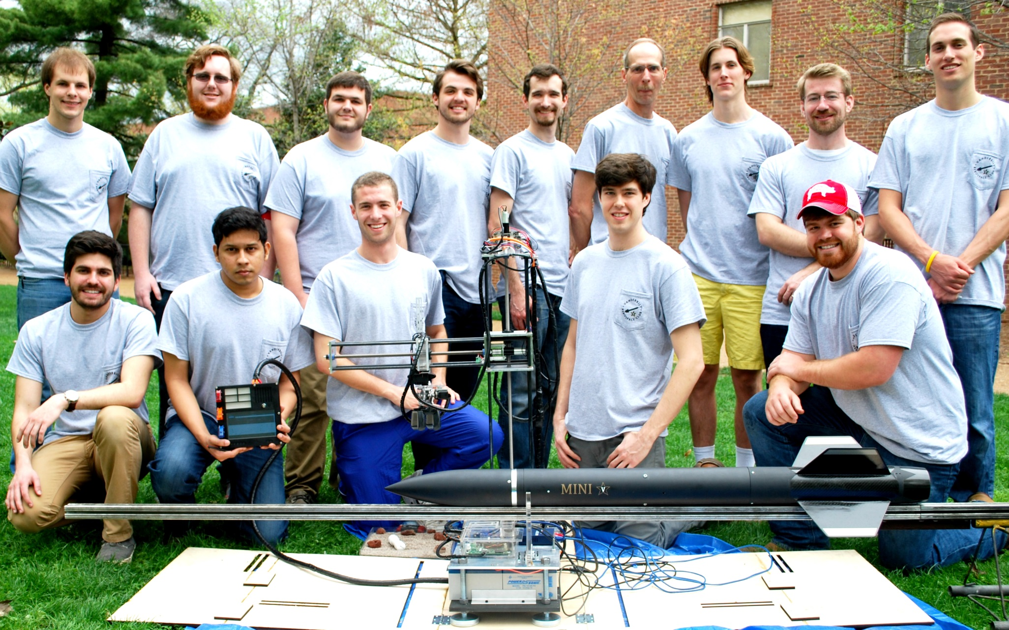
Vanderbilt Aerospace Club 2014-2015

